Slide 1

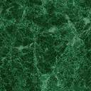
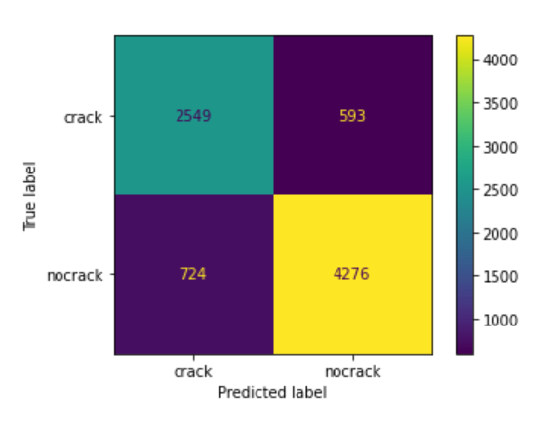
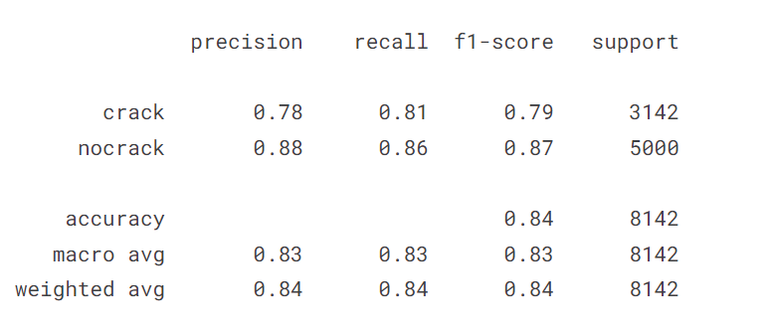
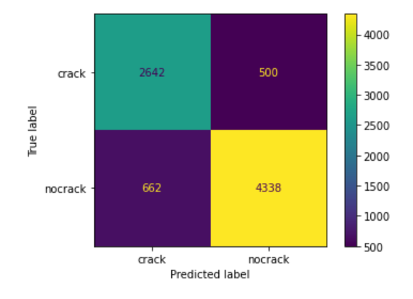
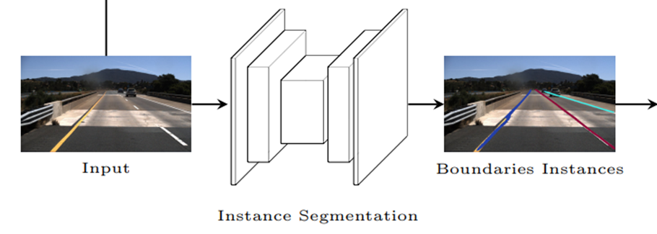
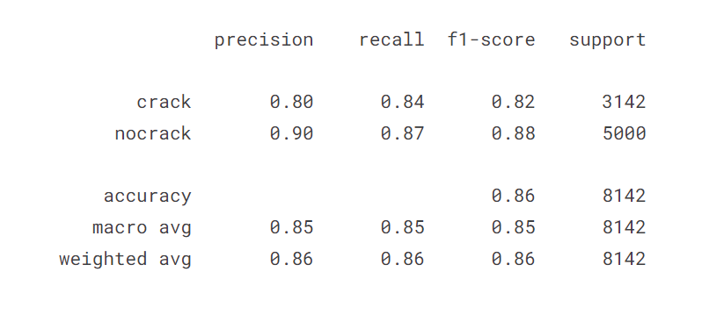
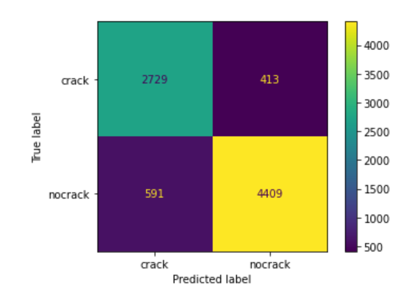
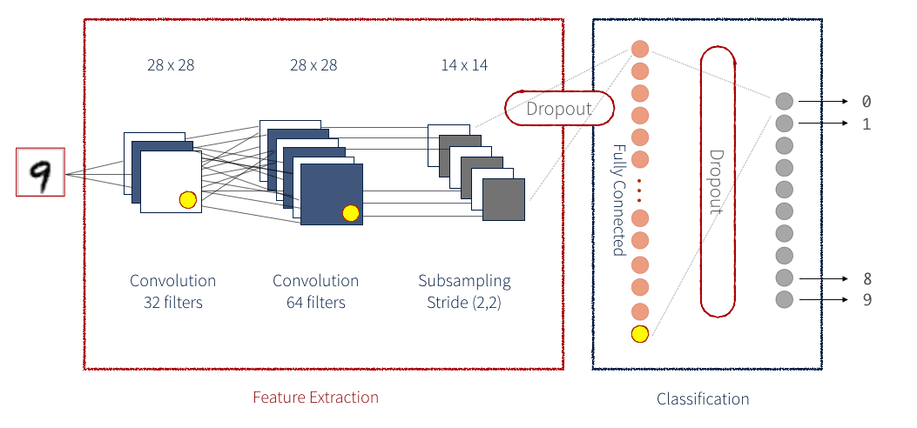
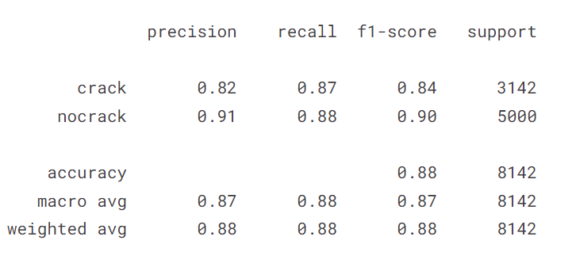
Computer Vision Use Case in Line Detection for Smart Vehicles (ECE884)
ADITYA DHAKA . JORGE MATEUS
INTRODUCTION
RESULTS AND DISCUSSION
A deep understanding of lane boundary position is vital for vehicle safety, which is needed to avoid collisions and localize vehicle. Lanes boundaries detection accuracy has increased significantly since introduction of deep learning, with majority of recent systems using convolutional neural networks to process sensorial data and infer high-level information. The use of LiDAR is extremely expensive therefore as an alternative, comparatively cheaper cameras are used which can utilize chromatic differences on the road.
Lane Detection
The number of FN and FP is high because we used 10 epochs (a hyperparameter that defines the number of times that the algorithm will work through the entire training dataset). This impacts the precision of the algorithm as TP/(TP+FP). The graphs bellow shows the increase of the precision as the epoch increase.
It also depends on the size of the architecture i.e., a much more advanced CNN.
Crack Detection
To further improve the crack algorithm effectiveness a few suggestions are:
Increase the epoch which will increase the time to train the model as well as demand more computational power.
The use more layers in the network and/or use large dataset. Image augmentation. Pre-process the image before training the model.
While this may improve the precision of the algorithm, the relationship with the output or precision is not linear, as there can be a threshold when the result stop getting better.
DATASETS
The table below tracks the accuracy at which cracks are identified.
Epoch 5
TuSimple dataset is used for lane detection. It is consists of 6408 1280×720 road images on US highways, divided in 3626 for training, and 2782 for testing. 410 images extracted from the training set have been used as validation set during training.
METHODS
CONCLUSIONS
Lane Detection:
We trained the CNN to recognize lane boundaries, rather than lane markings to avoid grouping different lane markings in a lane boundary to save processing time.
Instead of semantic segmentation, we performed instance segmentation on lane boundaries, to distinguish different lane boundaries without relying on clustering algorithms.
We used ERFNet architecture as baseline model since Mask R-CNN is not suggested for use in real-time application
We have successfully implemented Lane detection and further added crack detection feature in it (with the accuracy of 88% and F1 score .90) but due to the presence of noisy patterns like shadows, oil stains, and water spot etc, which have similar dark background intensity as crack pixels, making it harder to distinguish cracks pattern with no crack’s pavement. Therefore, more work needs to be done for removing such irregularities from images also.
Epoch 10
REFERENCES
[1] Tian, Y., Gelernter, J., Wang, X., Chen, W., Gao, J., Zhang, Y., Li, X.: Lane marking detection via deep convolutional neural network. Neurocomputing (2018)
[2] Bai, M., Mattyus, G., Homayounfar, N., Wang, S., Lakshmikanth, S.K., Urtasun, R.: Deep multi-sensor lane detection. In: 2018 IEEE/RSJ International Conference on Intelligent Robots and Systems (IROS). (2018)
[3] Chen, P., Lo, S., Hang, H., Chan, S., Lin, J.: Efficient road lane marking detection with deep learning. CoRR abs/1809.03994 (2018)
[4] Tian, Y., Gelernter, J., Wang, X., Chen, W., Gao, J., Zhang, Y., Li, X.: Lane marking detection via deep convolutional neural network. Neurocomputing (2018)
[5] Ren, S., He, K., Girshick, R., Sun, J.: Faster r-cnn: Towards real-time object detection with region proposal networks. In: Advances in NIPS. (2015)
[6] Neven, D., De Brabandere, B., Georgoulis, S., Proesmans, M., Van Gool, L.: Towards end-to-end lane detection: an instance segmentation approach. In: 2018 IEEE Intelligent Vehicles Symposium (IV), IEEE (2018) 286–291
[7] Pan, X., Shi, J., Luo, P., Wang, X., Tang, X.: Spatial as deep: Spatial cnn for traffic scene understanding. In: 32nd AAAI Conference on Artificial Intelligence. (2018)
Crack detection:
To detect crack, we used classification approach, in which, images and label are fed to deep learning architecture (50 layers deep resnet50). The model learns from it and when unknown images are provided, it predicts the label.
Epoch 15

